Slide 1
Grow our services with Openstack?
Ha Noi, August 25 2018
Presenter: NGUYEN TRUNG VAN
Email: trungvan@hostingviet.vn Mobile: 01656-95-86-88
Website: https://hostingviet.vn
Notes:
Notes

Slide 2
AN OVERVIEW ABOUT HOSTINGVIET.VN
Start Hosting business as a personal provider from 2012.
Start first company in 2014.
Start 2nd company in 2016 to replace the old one.
Main business: Hosting, Cloud Server, domain, develop managing system for customer, Web design.
Active customer at the moment: More than 14.000 customers.
Provide Openstack Cloud service from 09/2017.

Slide 3
5 REASONS TO UPGRADE TO CLOUD
Bad experience when data lost with traditional server, Storage disk fail.
Disadvantage when use SolusVM and VMWare.
Store data not centralized, hard to manage.
IO performance of VM is low, compared to world-famous providers.
Hard to scale-up, hard to maintain, hard to serve big customer.

Slide 4
1. BAD EXPERIENCE WHEN DATA LOST WITH TRADITIONAL SERVER WHEN DISK FAIL.
2014, First test with 10 Enterprise SSD for a Physical server.
After 3 months test with high write load, 2 SSD disk suddenly stopped working, server crashed.

Slide 5
2. DISADVANTAGES WHEN USE SOLUSVM AND VMWARE
VMWare is not friendly with automation and Resful API/PHP. Our self-develop application for manage services using PHP.
Don’t have a chance to try with VMWare VCenter.
VMWare License is expensive, speciallly when system grow up.
SolusVM: Good API but lots of limitation. And suitable for small/personal provider. Runs on single server.

Slide 6
3. STORAGE DATA NOT CENTRALIZED, HARD TO MANAGE
Single server don’t have strength of all storage servers in one.
Not centralized, hard to manage and maintain.
Don’t have graphics statistic, unable to manage IO/IOPS of each VM.
Whole data (Volumes/block) unable to manipulate and control. Can’t check Volomes performance.

Slide 7
4. IO PERFORMANCE OF SYSTEM IS LOW (raid), COMPARED TO WORLD-FAMOUS PROVIDERS
Disk performance is low, about 1.000 IOPS. Bottleneck when system get into high loading state.
Compare to world-famous cloud providers, non-cloud server has very low IO. World-famous provider often reach 30.000 IOPS

Slide 8
5. HARD TO SCALE-UP, HARD TO MAINTAIN, HARD TO SERVE BIG CUSTOMER
We need a solution to rapid grow-up servers, easy to extend and maintain.
We need a synergy of servers.
We need a stable system to help our customer focus on their business.
Almost world’s provider use CLOUD-Infrastructure

Slide 9
WHY WE CHOOSE OPENSTACK?
Large community, specially supported by largest corporation in the world: Rackspace, Redhat, Dell, Cisco...
Enough features for a public cloud provider.
Easy API to integrate with our management system developed using PHP.
Easy to scale-up, easy to maintain.
Open-source free.

Slide 10
WHAT WE FACED?
Incompatible hardware.
Zero experience in deploy Cloud System.
Hard to choose Storage server, and software decision Ceph or ScaleIO.
Hard to move VPS from SolusVM, VMWare to Openstack.

Slide 11
OVERVIEW ABOUT CLOUD OF HOSTINGVIET
Deployed High-Availability Openstack.
Storage with Dell ScaleIO, good performance.
Storage switch 10Gbps/port.
Easy to extend and upgrade as requested from customer include RAM, CPU, Storage, Network.
Friendly customer’s Self-build interface to manage VPS based on Openstack API

Slide 12
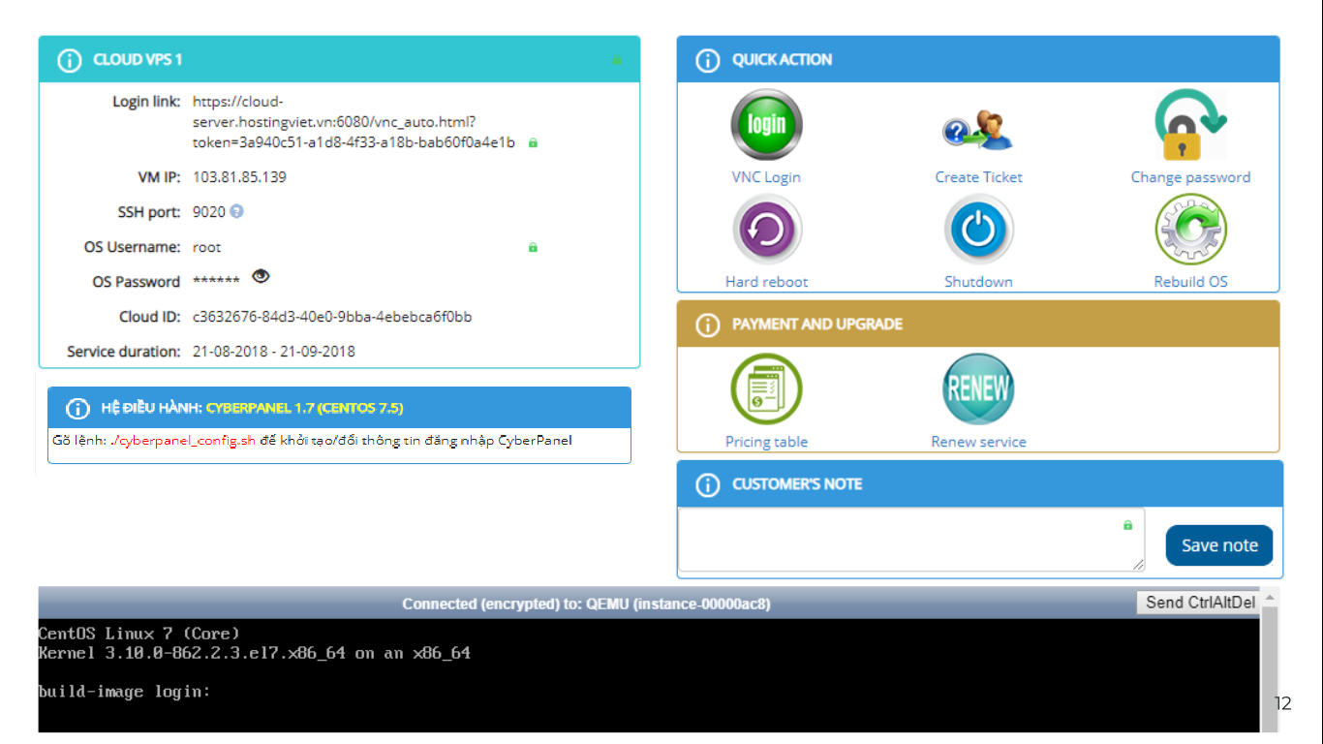

Slide 13
OUR CLOUD INFRASTRUCTURE AND ACHIEVED?
Controller | 02 servers
Storage | 10 servers
Compute | 26 servers
Storage Switch | 02 storage switches
Network switch | 02 network switches
VM | 2.000+ and max tested IOPS about 400k+
Hardware and software firewall, Backup Server. Stable system and working great, easy to maintain + extend, easy to manage, pro service.

Slide 14
Budget
Performance
Data safe and security
Easy to maintain + control
Easy to extend
Stable, less of error
CÁC LƯU Ý KHI XÂY DỰNG HỆ THỐNG

Slide 15
THANK YOU FOR LISTENING! We are HostingViet.vn
THIEN QUANG DIGITAL TECHNOLOGY J.S.C ADD: 11th Floor, No.11A8, Sun Square Tower, 21 Le Duc Tho Street
Nam Tu Liem, Hanoi, Viet Nam
Tell: +84 (24) 66 567 555
Email: hotro@hostingviet.vn
Website: www.hostingviet.vn

